Slide 1
Ashutosh Sanjay Thite
Roll No. 31462
Inhouse Internship – Big Data and Text Analytics Group, PICT.
Problem Statement 1 :
Design and Develop a recommendation system with collaborative/content/hybrid algorithm with context. Test on the accuracy and build a website/mobile application for the same.

Slide 2
Study of Recommendation System
Week 1

Slide 3
Contents
Introduction
Need of Recommendation Systems
Content – Based Filtering
Collaborative Filtering
Hybrid Filtering
References

Slide 4
INTRODUCTION
On the Internet, where the number of choices is overwhelming, there is need to filter, prioritize and efficiently deliver relevant information in order to solve the problem of information overload, which has created a potential problem to many Internet users.
Recommendation systems solve this problem by searching through large volume of dynamically generated information to provide users with personalized content and services.

Slide 5
INTRODUCTION
Recommender systems are information filtering systems that deal with the problem of information overload by filtering vital information fragment out of large amount of dynamically generated information according to user’s preferences, interest, or observed behavior about item.
Recommender system has the ability to predict whether a particular user would prefer an item or not based on the user’s profile.

Slide 6
Need for Recommendation Systems
Recommender systems are beneficial to both service providers and users .
They provide user the relevant information easily, saving time and efforts.
They reduce transaction costs of finding and selecting items in an online shopping environment .
Recommendation systems have also proved to improve decision making process and quality .
In e-commerce setting, recommender systems enhance revenues, for the fact that they are effective means of selling more products .
In scientific libraries, recommender systems support users by allowing them to move beyond catalog searches.

Slide 7
Content-based filtering
Content-based technique focuses more on the analysis of the attributes of items in order to generate predictions.
In content-based filtering technique, recommendation is made based on the user profiles using features extracted from the content of the items the user has evaluated in the past.

Slide 8
Content-based filtering
Items that are mostly related to the positively rated items are recommended to the user.
It could use Vector Space Model or Probabilistic models such as Naïve Bayes Classifier, Decision Trees or Neural Networks to model the relationship between different documents.

Slide 9
Collaborative Filtering
Collaborative filtering is a domain-independent prediction technique for content that cannot easily and adequately be described by metadata such as movies and music.
Collaborative filtering technique works by building a database (user-item matrix) of preferences for items by users. It then matches users with relevant interest and preferences by calculating similarities between their profiles to make recommendations.

Slide 10
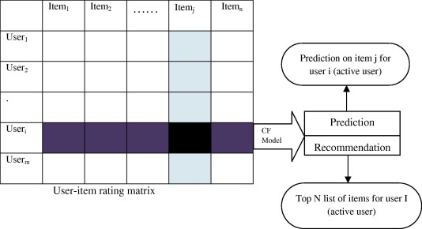
Collaborative Filtering
Such users build a group called neighborhood. An user gets recommendations to those items that he has not rated before but that were already positively rated by users in his neighborhood.

Slide 11
Hybrid Filtering
Hybrid filtering technique combines different recommendation techniques in order to gain better system optimization to avoid some limitations and problems of pure recommendation systems.
Combination of algorithms will provide more accurate and effective recommendations than a single algorithm as the disadvantages of one algorithm can be overcome by another algorithm.

Slide 12
References
F.O. Isinkaye, Y.O. Folajimi, B.A. Ojokoh,
Recommendation systems: Principles, methods and evaluation,
Egyptian Informatics Journal, Volume 16, Issue 3, 2015,
https://www.sciencedirect.com/science/article/pii/S1110866515000341
https://www.slideshare.net/CrossingMinds/recommendation-system-explained

